Slide 1
Upa in Inpatient ASUC
First cases,
Oh, and one CD case

Slide 2
Three cases
MWZ – 67M, UC Dx < 1y ago, prior mesalamine, budesonide, Entyvio
Peak CRP 23.4, rectosigmoid colon is one confluent ulcer, 20+ BM daily
Recently treated COVID – completed Paxlovid last week
MAR – 29F UC on IFX/Aza/Pred Dx Feb 2022
Undetectable IFX, ready for colectomy. Peak CRP 17.4
But CTE in ER found segmental PEs in lower lungs – surgery wants to wait
TGH – 25M CD failed IFX, ADA, on Stelara – failing
Prior colectomy, recent peristomal abscess unroofed, now fistula draining stool
soaks 4x4 in 6h
Stricture 4 cm prox to stoma – dilated to 20 mm
Ulcerated throughout SB on scope. Used Entocort instead of Solumedrol b/c infxn

Slide 3
Dosing
Start IVCS – 30 mg solumedrol q12
Lovenox daily
Except MAR – UFH to therapeutic anti-Xa, able to stop for surgery
Took 48+ h to get therapeutic by nomogram
Upa 30 mg bid po (plus Canasa for urgency bid)
Inpatient pharmacy – email Randy Regal to approve
Start outpatient approval ASAP
Via EAA Specialty Pharmacy – NOT transitions of care
2 paths –
Insurance prior auth
Abbvie patient assist (not available for Medicare/Medicaid)

Slide 4
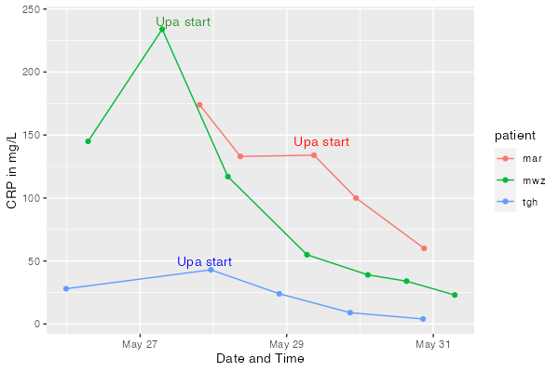
Results so far – by CRP

Slide 5
Symptomatically
BM number and form much improved by day 3
Blood down to trace or none by day 3
Urgency much improved by day 3 – no longer using bedside commode
Fatigue improved by Day 3
Fistula drainage nearly stopped by Day 4

Slide 6
Risks
Shingles #1 – Shingrix ASAP
VTE – NO MISSED DOSES of lovenox
Mild LFTs
CK elevation – asymptomatic
TB, Infections, skin ca, lymphoma

Slide 7
Outcomes so far
MWZ likely to avoid colectomy
DC on Upa (or IFX if denied)
MAR likely to choose colectomy (even though a lot better) on Thursday
TGH fistula much improved
Needs Upa, may have to go back to Stelara
Phase 3 CD data available online, not officially published

Slide 8
At discharge
Convert to 45 mg po daily x 8 weeks for outpatient
Inpatient pharmacy only has 30 mg SR dose
Get baseline FCP and CRP before discharge
Order IBD Home Care program (default is checked)
NP calls patient, make sure they got meds, doing well
Orders CRP, FCP, PRO questionnaire
All at 1, 3, 6, 12 weeks
Notify you if things are going wrong so you can send to ADTU

